Slide 1



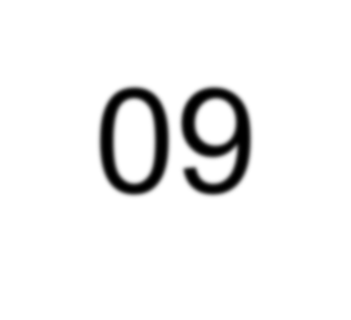





Computer Graphics
Lecture 09
2D Viewing & Clipping

Slide 2
Topics
Viewing Pipeline: describes a series of transformation to display
world data on a device
Viewing Transformation: how it transforms world data for a device
Viewing Coordinate Mapping:
Clipping Algorithms:
Window

Slide 3







Viewing Pipeline
Suppose you are watching a hill from your roof Only rectangular block view of scene can be seen through eyes. This block is called window.
Y_{w}
The window can be represented by world
coordinate system.
^{y}wmax
^{y}wmin
Window
(x ,y )
w w
Now we need to present this window on a device called viewport.
X_{w}
^{x}wmin
^{x}wmax
Window
Viewing Transformation
Viewport
Y_{v}
^{y}vmax ^{y}vmin
Window to Viewport Transformation
Viewport
(x_{v},y_{v})
Now how a point in window is to be represented in viewport?
X_{v}
^{x}vmin
^{x}vmax

Slide 4
Viewing Transformation
Y_{w}
^{y}wmax ^{y}wmin
Process of viewing transformation:
Normalization Transformation
Work Station Transformation
Window
(x ,y )
w w
X
w
^{x}wmin
^{x}wmax
Normalization Transformation:
As image defined as set of pixels, it displays in different size in different devices
Suppose an image defined in low resolution device shrinks in size in high resolution device because a number of pixels in high resolution device takes less space than in low resolution device.
To make it device independent we need Normalize transformation. It transfer window Coordinate to normalize device coordinate makes it device independent. It consider 1 unit in both x and y axis.
Y_{v}
^{y}vmax ^{y}vmin
Viewport
(x ,y )
v v
X_{v}
^{x}vmin
^{x}vmax
(0,1)
(1,1)
Viewport
(1,0)
(0,0)
World Coordinate
Normalization
Normalize Coordinate
Device
0-1

Slide 5
Viewing Transformation
Y_{w}
^{y}wmax
Normalization Transformation: x=x_{n} . x_{w}
y=y_{n} . Y_{w}
Here
(x,y)=Actual device coordinate (x_{w} , Y_{w})= Window coordinate
(x_{n} , Y_{n})= Normalize coordinate (scaling)
Window
(x_{w},y_{w})
y
wmin
X_{w}
^{x}wmin
^{x}wmax
Work Station Transformation:
Here world coordinate transforms to Normalize coordinate and then apply work station to get device coordinate
World Coordinate
Normalization
Normalize
Coordinate
Work Station
Device Coordinate
We can write V=N.W W=TST⁻¹
Here,
T→ means translate image to origin S→ scaling according to device
T⁻¹→ inverse translate image
Window
T
S
_{T}-1

Slide 6
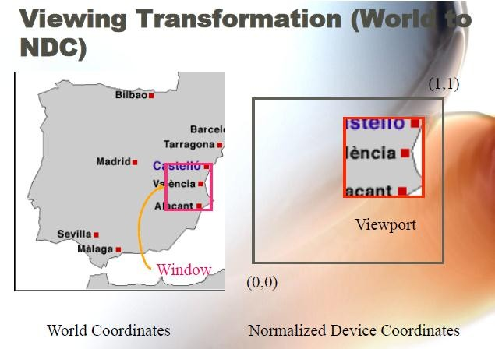
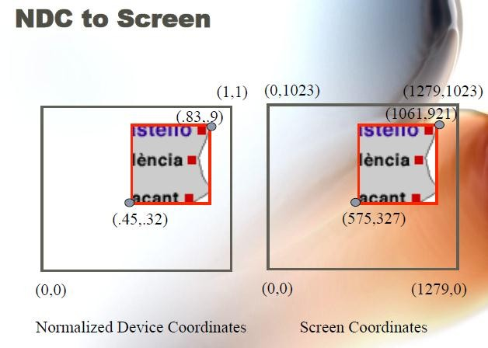
Transformation Process

Slide 7
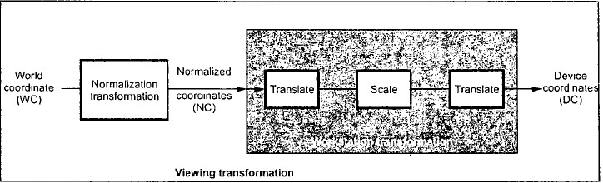
Viewing Transformation
We can write V=N.W W=TST⁻¹
Here,
T→ means translate image to origin
S→ scaling according to device
T⁻¹→ inverse translate image
1
𝑇 = 0
^{−𝑥}𝑤𝑚𝑖𝑛
0
1
^{−𝑦}𝑤𝑚𝑖𝑛
0
0
1
Window
T
𝑆_{𝑥} 0 0
𝑆 = 0 𝑆_{𝑦} 0
0 0 1
S
1
𝑇⁻¹ = 0
^{𝑥}𝑣𝑚𝑖𝑛
0 0
1 0
^{𝑦}𝑣𝑚𝑖𝑛 ¹
𝑆_{𝑥} 0
^{𝑥}𝑣𝑚𝑖𝑛 ^{− 𝑥}𝑤𝑚𝑖𝑛^{. 𝑆}𝑥
0
𝑆_{𝑦}
^{𝑦}𝑣𝑚𝑖𝑛 ^{− 𝑦}𝑤𝑚𝑖𝑛^{. 𝑆}𝑦
0
0
1
𝑇𝑆𝑇⁻¹ =
_{T}-1

Slide 8
Window to Viewport Mapping
Let a window point (x_{w}, y_{w}) mapping to viewport (x_{v,}y_{v)}
Y_{w}
Y_{v}
^{y}vmax ^{y}vmin
y
wmax
Window
Viewing
Viewport
(x_{v},y_{v})
^{y}wmin
(x ,y )
Transformation X
w w
w
^{x}wmin
^{x}wmax
X_{v}
As the relative position of both points is same, we can write
^{x}vmin
^{x}vmax
a c
x
^{𝑥}𝑣 ^{− 𝑥}𝑣𝑚𝑖𝑛 ^{𝑥}𝑤 ^{− 𝑥}𝑤𝑚𝑖𝑛
b
=
y
^{𝑥}𝑣𝑚𝑎𝑥 ^{− 𝑥}𝑣𝑚𝑖𝑛 ^{𝑥}𝑤𝑚𝑎𝑥 ^{− 𝑥}𝑤𝑚𝑖𝑛
d
^{𝑥}𝑣𝑚𝑎𝑥 ^{− 𝑥}𝑣𝑚𝑖𝑛
^{𝑥}𝑤𝑚𝑎𝑥 ^{− 𝑥}𝑤𝑚𝑖𝑛
𝑥 − 𝑎 ₌ 𝑦 − 𝑐
^{𝑥}𝑣 ^{= 𝑥}𝑣𝑚𝑖𝑛 ⁺
(𝑥 − 𝑥 )
𝑤
𝑤𝑚𝑖𝑛
𝑏 − 𝑎 𝑑 − 𝑐
^{𝑥}𝑣 ^{= 𝑥}𝑣𝑚𝑖𝑛 ^{+ 𝑆}𝑥 ^{(𝑥}𝑤 ^{− 𝑥}𝑤𝑚𝑖𝑛⁾
^{𝑦}𝑣 ^{= 𝑦}𝑣𝑚𝑖𝑛 ^{+ 𝑆}𝑦 ^{(𝑦}𝑤 ^{− 𝑦}𝑤𝑚𝑖𝑛⁾
Sx and Sy are scaling factors
𝑦 = 𝑐 + ^{𝑑 − 𝑐} (𝑥 − 𝑎)
𝑏 − 𝑎

Slide 9
Window to Viewport Mapping
Let a window point (x_{w}, y_{w}) mapping to viewport (x_{v,}y_{v)}
Y_{w}
^{y}wmax ^{y}wmin
Y_{v}
^{y}vmax
Viewport
(x_{v},y_{v})
Window
Viewing
(x ,y )
Transformation ^{yvmin}
w w
X_{w}
X_{v}
^{x}wmin
^{x}wmax
^{x}vmin
^{x}vmax
𝑥_{𝑤𝑚𝑖𝑛} = 20
𝑥_{𝑤𝑚𝑎𝑥} = 80
𝑦_{𝑤𝑚𝑖𝑛} = 40
𝑦_{𝑤𝑚𝑎𝑥} = 80
(𝑥_{𝑤}, 𝑦_{𝑤}) = (30, 80)
₌ ^{𝑥}𝑣𝑚𝑎𝑥 ^{− 𝑥}𝑣𝑚𝑖𝑛
₌ 60 − 30 _{= 0.5}
𝑥_{𝑣𝑚𝑖𝑛} = 30
𝑥_{𝑣𝑚𝑎𝑥} = 60
𝑦_{𝑣𝑚𝑖𝑛} = 40
𝑦_{𝑣𝑚𝑖𝑛} = 60 (𝑥_{𝑣}, 𝑦_{𝑣}) =?
𝑆
𝑥
80 − 20
^{𝑥}𝑤𝑚𝑎𝑥 ^{− 𝑥}𝑤𝑚𝑖𝑛
₌ ^{𝑦}𝑣𝑚𝑎𝑥 ^{− 𝑦}𝑣𝑚𝑖𝑛
₌ 60 − 40 _{= 0.5}
𝑆
𝑦
80 − 40
^{𝑦}𝑤𝑚𝑎𝑥 ^{− 𝑦}𝑤𝑚𝑖𝑛
^{𝑥}𝑣 ^{= 𝑥}𝑣𝑚𝑖𝑛 ^{+ 𝑆}𝑥 ^{(𝑥}𝑤 ^{− 𝑥}𝑤𝑚𝑖𝑛⁾
^{𝑦}𝑣 ^{= 𝑦}𝑣𝑚𝑖𝑛 ^{+ 𝑆}𝑦 ^{(𝑦}𝑤 ^{− 𝑦}𝑤𝑚𝑖𝑛⁾
𝑥_{𝑣} = 30 + 0.5 30 − 20 = 35
𝑦_{𝑣} = 40 + 0.5 80 − 40 = 60

Slide 10
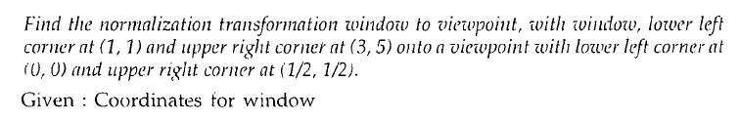
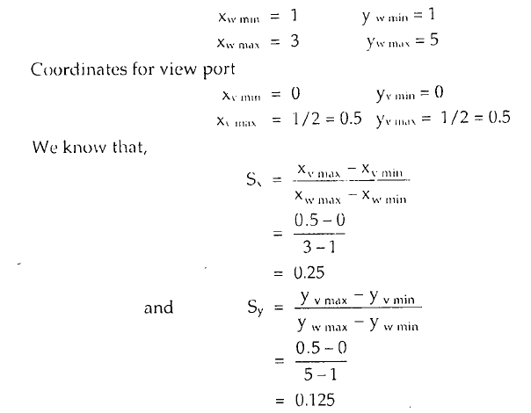
Example on Workstation Transformation
Y_{w}
^{y}wmax ^{y}wmin
Window
(3,5)
(1,
1)
X_{w}
^{x}wmax
^{x}wmin
Y_{v}
^{y}vmax
^{y}vmin
^{Viewport} (1/2,1/2)
(0,0) x_{vmin}
^{x}vmax

Slide 11
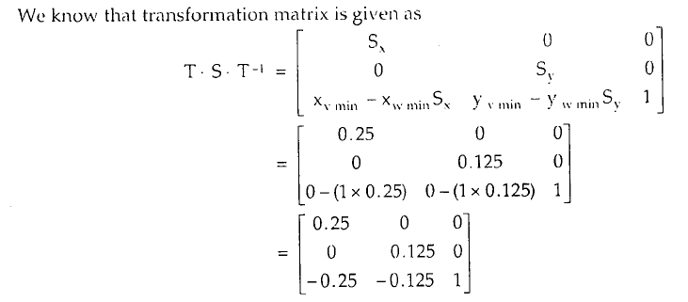
Example on Workstation Transformation

Slide 12






Window & Clipping
Window
Clipping: The procedure that identifies the portion of a picture That are either inside or outside of a specified region of space is referred to as Clipping. The region against which an object is to be clipped is called a clip Window or clipping window.
Types of Clipping: Discarding the portion outside the window Types:
Point Clipping
Line Clipping
Cohen-Sutherland Algorithm
Cyrus-Beck Algorithm
Liang-Bersky Algorithm
Polygon Clipping
Sutherland-Hodgeman Algorithm
Curve Clipping
Text Clipping

Slide 13
Point Clipping
Ymax
. (x,y)
Define a window first
Conditions for clipping (x,y)
Xmin ≤ x ≤ Xmax
Ymin ≤ y ≤ Ymax
Ymin
Xmin Xmax

Slide 14
Line Clipping
p5
(xl, yt)
(xr, yt)
p1
p3
Conditions for clipping (x,y)
Xmin ≤ x ≤ Xmax
Ymin ≤ y ≤ Ymax
p6
p8
p4
p2
(xl, yb)
p7
Before Clipping
(xr, yb)
A line is visible if both of its end points are in the window.

Slide 15
Line Clipping
p5
A point is visible if
xl < X < xr and
yb < Y < yt
(xl, yt)
(xr, yt)
p1
p3
p6
p8
p4
p2
(xl, yt)
p5
(xr, yt)
(xl, yb)
(xr, yb)
p7
p3
p6
Before Clipping
p1-p2 → Reject
p3-p4 → Consider (Accept) p5-p6 → Clipping Required p7-p8 → Clipping Required
p8
p4
(xl, yb)
p7 After Clipping
(xr, yb)

Slide 16
Cohen-Sutherland Algorithm
Region Checks: Trivially reject or accept lines and points.
Fast for large windows (everything is inside) and for small windows (everything is outside).
Each vertex is assigned a four-bit outcode.
Bit 1 | <-- sign bit of (yt-Y) | -- | point is above window
Bit 2 | <-- sign bit of (Y-yb) | -- | point is below window
Bit 3 | <-- sign bit of (xr-X) | -- | point is to right of window
Bit 4 | <-- sign bit of (X-xl) | -- | point is to left of window

Slide 17
Cohen-Sutherland Clipping
ABRL Code
Bit 1: Above
Bit 2: Below
Bit 3: Right
Bit 4: Left
1
001 | 1000 | 1010
001 | 0000 | 0010
101 | 0100 | 0110
0
0
A line can be trivially accepted if both endpoints have an outcode of 0000.
A line can be trivially rejected if any corresponding bits in the two outcodes are both equal to 1. (This means that both endpoints are to the right, to the left, above, or below the window.) Can be computed with a logical AND.

Slide 18
Cohen-Sutherland Clipping
p5
(xl, yt)
(xr, yt)
1
001 | 1000 | 1010
001 | 0000 | 0010
101 | 0100 | 0110
p1
p3
p6
p8
0
p4
p2
0
(xl, yb)
(xr, yb)
p7
ABRL Code
ABRL Code
P3 → 0000 –Zero P4 → 0000 –Zero AND → 0000 –Zero
P1 → 0001 – Non Zero P2 → 0001 – Non Zero
AND → 0001 – Non Zero
p1p2 is completely outside
REJET LINE
p3p4 is completely inside
ACCEPT LINE

Slide 19
Cohen-Sutherland Clipping
p5
(xl, yt)
p5’
(xr, yt)
1
001 | 1000 | 1010
001 | 0000 | 0010
101 | 0100 | 0110
p1
p3
p6
p8
0
p4
p2
0
(xl, yb)
(xr, yb)
p7
ABRL Code
Let p5’ is intersection on window
P5’ → 0000 – Zero P6 → 0000 – Zero AND → 0000 – Zero
P5’p6 is inside
P5 → 1000 – Non Zero P6 → 0000 – Zero
AND → 0000 – Zero
Clipping is Required
p5p5’ is outside

Slide 20
Cohen-Sutherland Clipping
p5
(xl, yt)
p5’
(xr, yt)
1
001 | 1000 | 1010
001 | 0000 | 0010
101 | 0100 | 0110
p1
p3
p6
p8
0
p4
p2
0
(xl, yb)
p7’
(xr, yb)
p7
ABRL Code
Let p7’ is intersection on window
p7p7’ → clipped
Let p7’ is intersection on window
P7’ → 0000 – Zero
P8 → 0010 – Non Zero
AND → 0000 – Zero
P7 → 0100 – Non Zero P8 → 0010 – Non Zero
AND → 0000 – Zero
Clipping is Required
Clipping is Required

Slide 21
Cohen-Sutherland Clipping
p5
(xl, yt)
p5’
(xr, yt)
1
001 | 1000 | 1010
001 | 0000 | 0010
101 | 0100 | 0110
p1
p3
p6
p8
0
p8’
p4
p2
0
(xl, yb)
p7’
(xr, yb)
p7
Let p8’ is intersection
on window
p8p8’ → clipped
P8’ → 0000 – Zero P7’ → 0000 – Zero
AND → 0000 – Zero
P8’p7’ is completely inside

Slide 22
Cohen-Sutherland Clipping
Prob: Let ABCD be the rectanguler window with A(20,20), B(90,20), C(90,70), D(20,70). Find the codes for endpoints and use Cohen-Sutherland algorithm to clip lines with P1(10,30) and P2(80,90).
P2(80,90)
Step 1: Find TBRL
1010
C(90, 70)
P1→ 0001
P2 → 1000
1001
D(20, 70)
1000
P2’(x2,70)
Step 2: Check Visibility of P1P2
P1→ 0001 – Non Zero P2 → 1000 – Non Zero
0001
P1’(20,y1)
0000
0010
AND → 0000 – Zero
P1P2 is partially inside (trivially accepted)
P1(10,30)
0100
B(90, 20)
0110
0101
A(20, 20)
Step 3: Find intersection Points
m=(90-30)/(80-10)=0.85
(y1-30)/(20-10)=0.85 ➔ y1=39 (90-70)/(80-x2)=0.85 ➔ x2=57

Slide 23
Clipping Lines not Accepted or Rejected
In the case where a line can be neither trivially accepted nor rejected, the algorithm uses a “divide and conquer” method.
1001
D
1000
Example:
C
B
A
0001
E
H
F
G
Line AD:
Test outcodes of A (0001) and D (1000) . Here A and B =0000, accept or reject?
Calculate intersection point B, which is conceptually on
the window side of the dividing line. Here A and B=1000 which is non-zero, so it is outside the window. Then B and D=1000, so it is also nonzero hence outside.

Slide 24
Polygon Clipping
Sutherland-Hodgman Algorithm
Basic idea:
Consider each edge of the viewport individually
Clip the polygon against the edge equation
After doing all planes, the polygon is fully clipped

Slide 25
Polygon Clipping
Sutherland-Hodgman Algorithm
Original polygon
Clipping Window

Slide 26
Polygon Clipping
Sutherland-Hodgman Algorithm
Original polygon
Clipping Window
Left Clip

Slide 27
Polygon Clipping
Sutherland-Hodgman Algorithm
Original polygon
Clipping Window
Left Clip
Right Clip

Slide 28
Polygon Clipping
Sutherland-Hodgman Algorithm
Original polygon
Clipping Window
Left Clip
Right Clip
Top Clip

Slide 29
Polygon Clipping
Sutherland-Hodgman Algorithm
Original polygon
Clipping Window
Left Clip
Right Clip
Top Clip
Bottom Clip

Slide 30
Polygon Clipping
Sutherland-Hodgman Algorithm
Left Clip
Right Clip
Top Clip
Bottom Clip
4 Cases
in out
out
in
out
in
out v2
in
v1’
v2
v1’
v1
v2
v1
v1
v2
v1
Case 1: Output: (out→in)→ v1’v2
Case 2: Output: (in→out)→ v1v1’
Case 3: Output: (in→in)→ v1v2
Case 4: Output: (out→out)→ NIL

Slide 31
Sutherland-Hodgman Algorithm
Example
out
in
out
in
Left Clip
v2’
v2
v1-v2 – (in-in) – v1v2
v2-v3– (in-out) – v2v2’
v3-v1– (out-in) – v3’v1
v2’
v2
v3
Before
After
v3’
v3’
v1
v1
4 Cases
in out
out
in
out
in
out v2
in
v1’
v2
v1’
v1
v2
v1
v1
v2
v1
Case 1: Output: (out→in)→ v1’v2
Case 2: Output: (in→out)→ v1’
Case 3: Output: (in→in)→ v2
Case 4: Output: (out→out)→ NIL

Slide 32
Sutherland-Hodgman Algorithm
Example
in
out
in
out
Right Clip
v2’
v2
v1-v2 – (in-in) – v2
v2-v2’– (in-in) – v2’
v2’-v3’– (in-in) – v3’
v3’-v1– (in-in) – v1
v2’
v2
Before
After
v3’
v3’
v1
v1
4 Cases
in out
out
in
out
in
out v2
in
v1’
v2
v1’
v1
v2
v1
v1
v2
v1
Case 1: Output: (out→in)→ v1’v2
Case 2: Output: (in→out)→ v1’
Case 3: Output: (in→in)→ v2
Case 4: Output: (out→out)→ NIL

Slide 33
Sutherland-Hodgman Algorithm
Example
out
out
in
Top Clip
in
v2’
v2
v1-v2 – (in-in) – v2
v2-v2’– (in-in) – v2’
v2’-v3’– (in-in) – v3’
v3’-v1– (in-in) – v1
v2’
v2
Before
After
v3’
v3’
v1
v1
4 Cases
in out
out
in
out
in
out v2
in
v1’
v2
v1’
v1
v2
v1
v1
v2
v1
Case 1: Output: (out→in)→ v1’v2
Case 2: Output: (in→out)→ v1’
Case 3: Output: (in→in)→ v2
Case 4: Output: (out→out)→ NIL

Slide 34
Sutherland-Hodgman Algorithm
Example
Bottom Clip
v2’
v2
v1-v2 – (out-in) – v1’v2
v2-v2’– (in-in) – v2’
v2’-v3’– (in-out) – v2’’
v3’-v1– (out-out) – NILL
v2’
v2
in
in
v2’’
v2’’
v1’
out
v3’
v1’
After
v1
out
v3’
Before
v1
4 Cases
in out
out
in
out
in
out v2
in
v1’
v2
v1’
v1
v2
v1
v1
v2
v1
Case 1: Output: (out→in)→ v1’v2
Case 2: Output: (in→out)→ v1’
Case 3: Output: (in→in)→ v2
Case 4: Output: (out→out)→ NIL

Slide 35
The END

